Slide 1




Blockchain Based Election System

Slide 2
Introduction
Extensive research has been done on electronic voting systems that enable voters to vote at their convenience using a mobile phone, computer or any other electronic device.
Electronic voting system using blockchain is a secure and robust system that ensures anonymity of the voter, transparency, and robust functioning

Slide 3
Motivation
Our main motivation in this project is to provide a secure voting environment and show that a reliable e-voting scheme is possible using blockchain.
It’s important for us since elections can easily be corrupted or manipulated especially in small towns, and even in bigger cities located in corrupt countries.

Slide 4
Problem Statement
The voters might be on vacation, on a business trip or far away for any other reason, which will make impossible for that particular voter to vote for the capable candidate.
the long term, especially if there are hundreds of geographically distributed vote centers and millions of voters

Slide 5
Objectives
To provide a non-rigging election system
To provide a platform for voters outside towns
To provide secured voting system to the users.
To make it feasible for voters to vote from anywhere using any device especially nowadays as social distancing is very important due to covid-19.

Slide 6
Methodoloy
Blockchain:
Blockchain technology that shines like a star after the entrance and widespread acceptance of Bitcoin, is adopted to create an e-voting system for a secured election system.

Slide 7
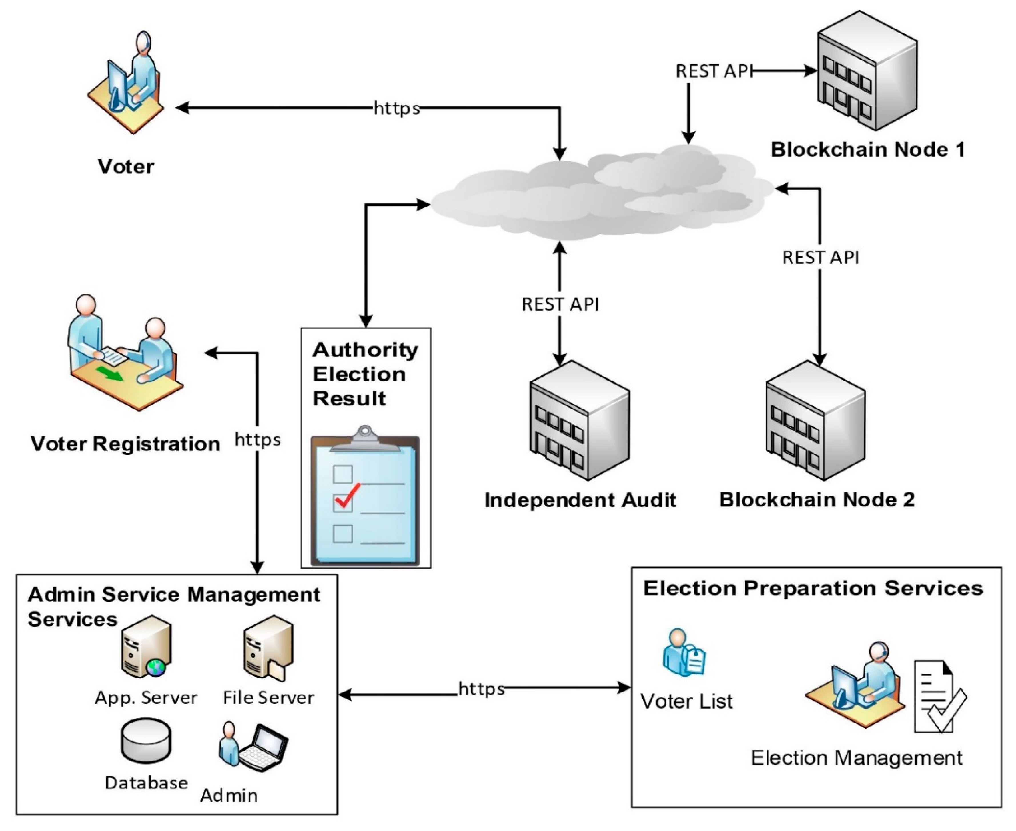
Blockchain

Slide 8

Framework
We used DJANGO, is a high-level Python Web framework that encourages rapid development.

Slide 9
Languages
PYTHON
HTML
CSS
JAVASCRIPT

Slide 10

(1) Home page

Slide 11
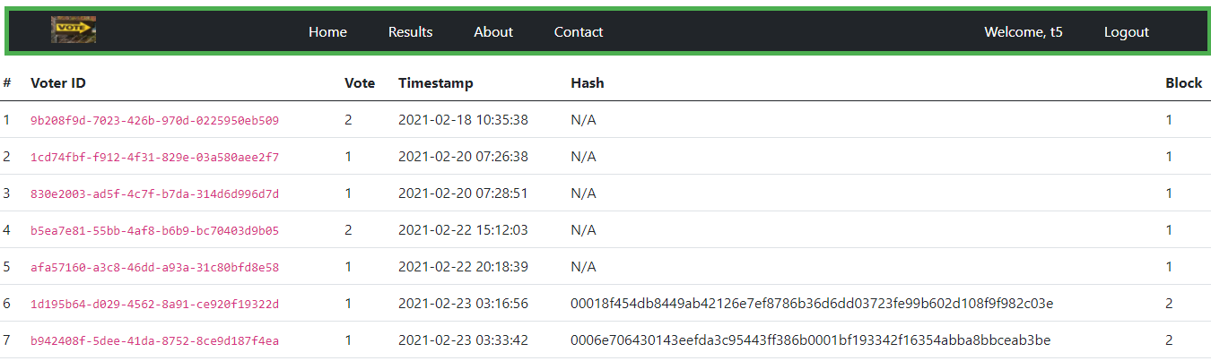
(2) Results till now

Slide 12

(3) Candidates

Slide 13
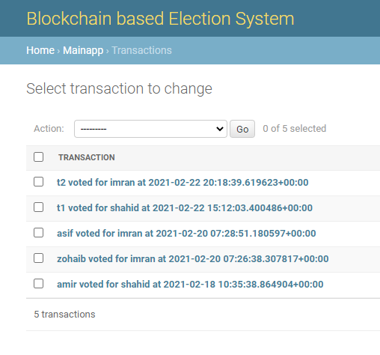
(4)Transactions

Slide 14
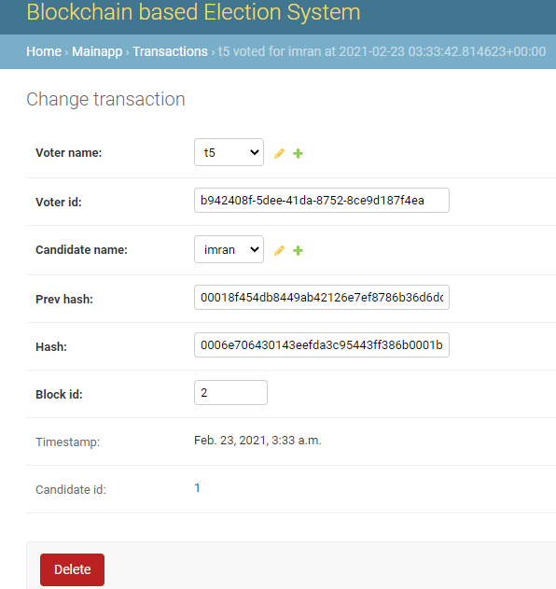
(5) Transaction details

Slide 15
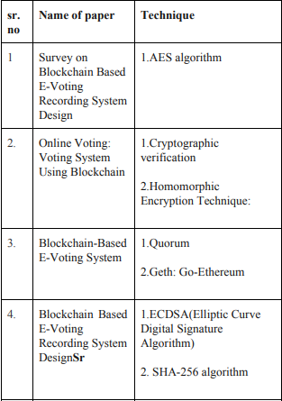
Literature Review & Related Work

Slide 16
Conclusion
A blockchain-based electronic voting system that enable secure and cost effecient election while guaranteeing voters privacy.
Electronic voting has been used in varying forms since 1970s with fundamental benefits over paper based systems such as increased efficiency and reduced errors. With the extraordinary growth in the use of blockchain technologies, a number of initiatives have been made to explore the feasibility of using blockchain to aid an effective solution to e-voting.

Slide 17
References
[1 ]Emre Yavuz ; Ali Kaan Koç ; Umut Can Çabuk ; Gökhan Dalkılıç (2018) Towards secure e-voting using ethereum blockchain .
[2] Design:Rifa Hanifatunnisa and Budi Rahardjo,(2017) , Blockchain Based E-Voting Recording System.
[3] S. Nakamoto, “Bitcoin: a peer-to-peer electronic cash system”, [Online]. Available: https://bitcoin.org/bitcoin.pdf .
[4] C.D. Clack, V.A. Bakshi, and L. Braine, “Smart contract templates: foundations, design landscape and research directions”, Mar 2017, arXiv:1608.00771.

Slide 18
References
[5] Y. Takabatake, D. Kotani, and Y. Okabe, “An anonymous distributed electronic voting system using Zerocoin“, IEICE Technical Report, pp. 127-131, 2016.
[6] F. Hao, P.Y.A. Ryan and P. Zielinski, "Anonymous voting by tworound public discussion", IET Information Security, vol. 4, pp. 62-67, June 2010.

Slide 19


